Slide 1







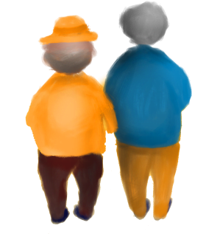

Elderlies Loneliness Reduction Capstone
Applying Clustering Algorithms
By Nancy Wu

Slide 2




CONTENTS
One
Two
Introduction
Data Description
Capstone Introduction
Data explanation and EDA analysis
Three
Four
Algorithms Applying
Conclusion
Introduce all the involved clustering algorithm concepts and results
Overall view and the next steps

Slide 3
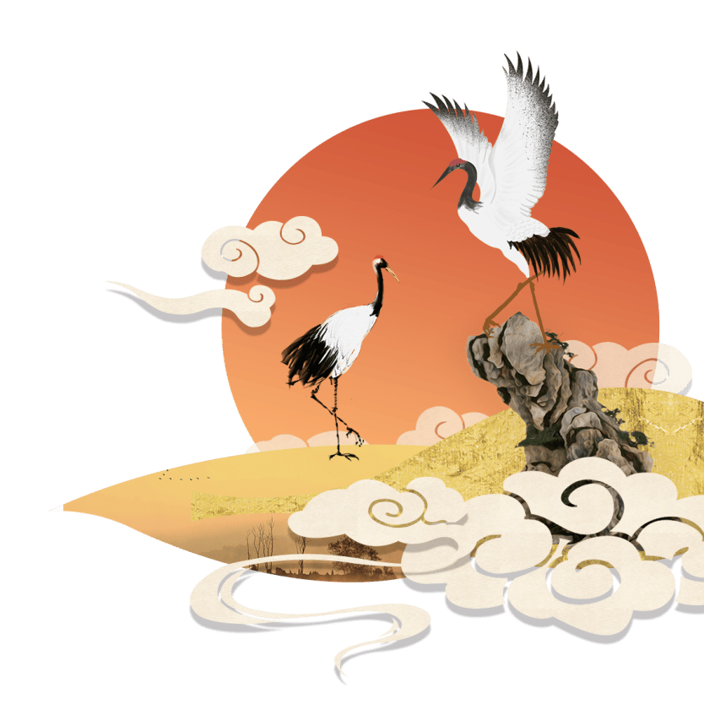
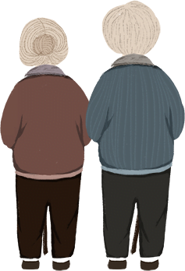
One
Introduction
Capstone introduction and project overview

Slide 4
One. Introduction
Background:
Group elderly individuals with similar characteristics together.
Smoking, Obesity, and lack of physical activity.
15 cigarettes!
(UneeQ, 2023）
Elderlies can connect and communicate with each other.
Loneliness issues
Alleviate the loneliness experienced by elderlies and fulfill their social needs.
Realistic Problem in Hometown
Purpose:
Notes:
UneeQ. (2023, 2 22). AI Ethics. Retrieved from UNEEQ: https://www.digitalhumans.com/blog/loneliness-and-the-role-of-conversational-ai-companions

Slide 5
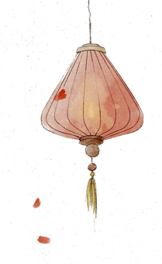
Project Overview:
One. Introduction
Data Sources | Aging and Chronic Disease report published by the Public Health Agency of Canada in 2021. American Community Survey (ACS) Demographic and Household Data 2021.
Methodologies | Clustering Algorithms: DBSCNE, K-Means, Mini Batch K-Means, Gaussian Mixture Model (GMM), Hierarchy, Elbow Method Similarity Measurements: Gower Distance, Silhouette Score(accuracy test) Sampling Method: Latin Hypercube Sampling(LHS) Dimension Reduction: t-SNE
Key Steps | Generate mock dataset according to exist research reports. Calculate the Similarity between each two data points using Gower Distance. Applying Gower Distance to all the algorithms mentioned. Calculate the Silhouette Score to compare algorithms. Generate dataset into 0 and 1 and applying to algorithms again. Testing Silhouette Score with original dataset and LHS dataset for compare purpose. Adding more data and select columns with higher variance to compare the Silhouette Score.

Slide 6
Two
Data Description
Mock dataset introduction and EDA analysis.

Slide 7


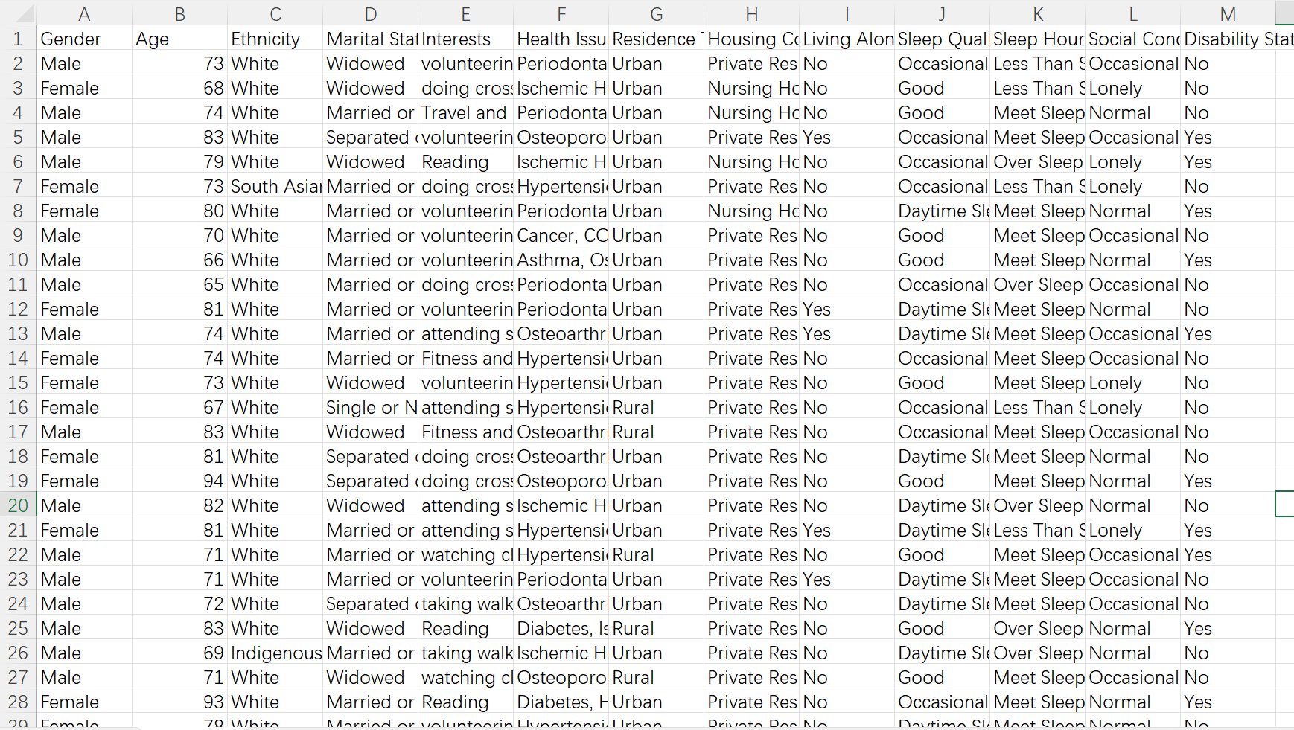
Two. Data Description
Data Handling
Quoting Data from the Report
Making Reasonable Guesses
Predicting and Filling Missing Data
5.0%
54.3%
59.3%
6.9%
Occasional hard to sleep
1.9%
38.8%
40.7%
Data Description
10,000 rows
13 columns: Gender/Age/Interests/Health Issues/Ethnicity/Living Alone/Sleep Quality/Social Condition…
Notes:
Public Health Agency of Canada. (2020). Aging and Chronic Diseases. Ottawa: Public Health Agency of Canada.

Slide 8
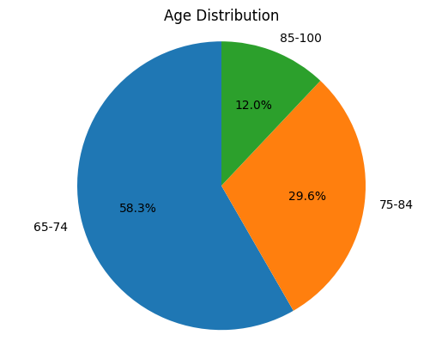
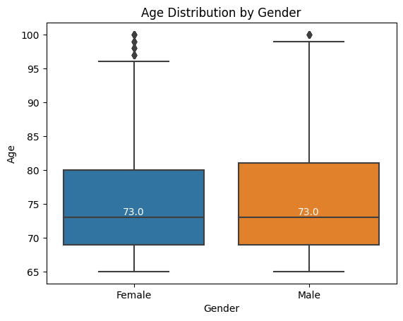
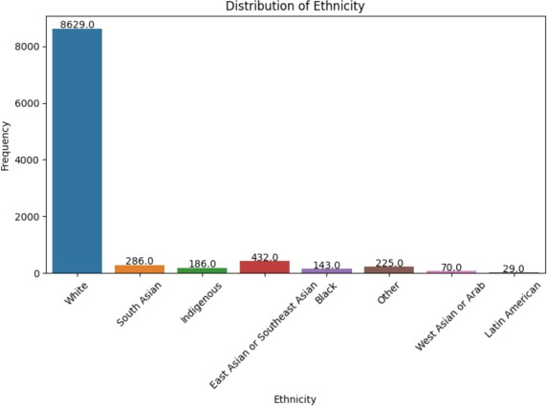
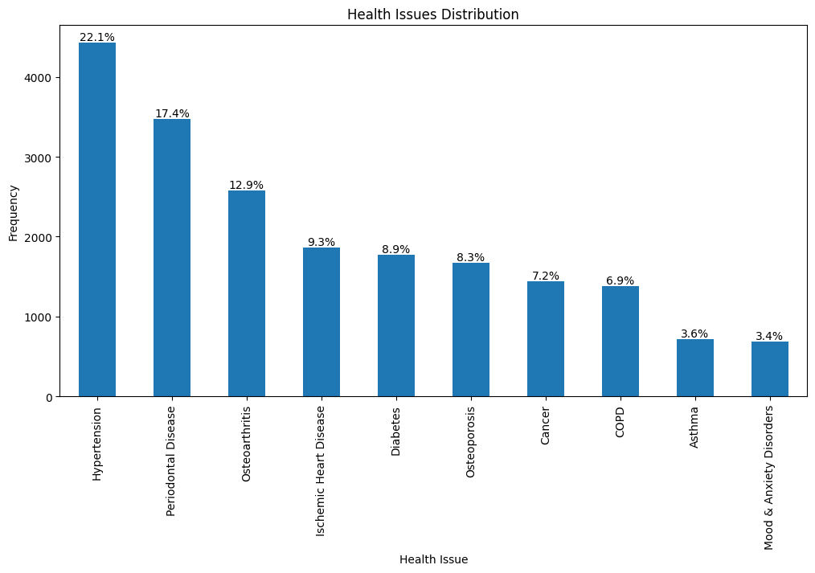
Two. Data Description
EDA Analysis (Partial)

Slide 9
Three
Algorithms Applying
Gower Distance, t-SNE, DBSCNE, KMeans, MiniBatchKMeans, GMM, Hierarchy, Silhouette Score, Dataset Adjust, LHS, Elbow Method

Slide 10

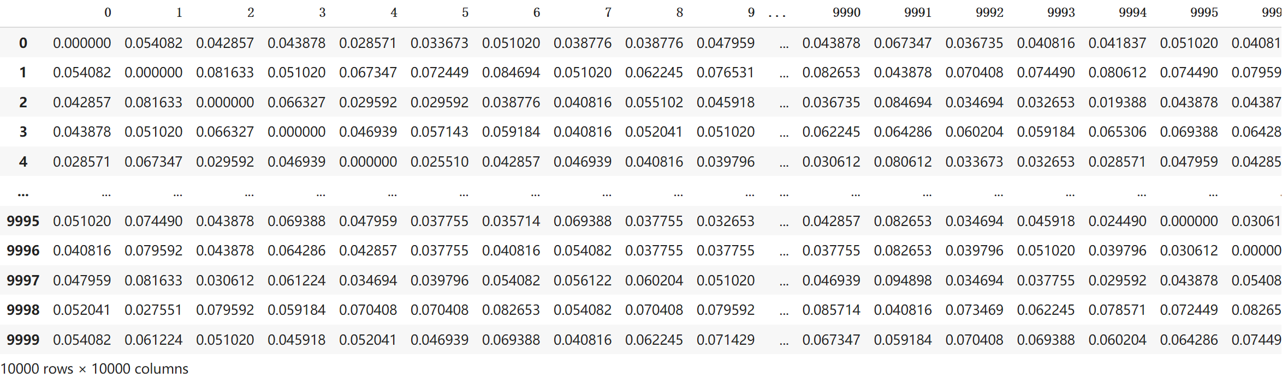
calculated the pairwise distance between every two data points
Gower Distance(Kesh, 2020):
a dataset of dimensions 10000x10000
Three. Algorithms Applying
Notes:
Kesh, S. (2020, 5 19). How to calculate Gower’s Distance using Python. Retrieved from Medium: https://medium.com/analytics-vidhya/concept-of-gowers-distance-and-it-s-application-using-python-b08cf6139ac2

Slide 11
Calculates the Within-Cluster Sum of Square (wcss), which represents the total square distance between the points with the centroid within one cluster
Value will decrease when the cluster number increased
visualize the decreased wcss and find the rapidly changed part
Elbow Method(Saji, 2021):
* The wcss usually calculate for kmeans method. For other clustering algorithms like GMM, it could calculate Bayesian Information Criterion(BIC), then following the Elbow method (Sarkar, 2019).
Three. Algorithms Applying
Notes:
Saji, B. (2021, 1 20). Elbow Method for Finding the Optimal Number of Clusters in K-Means. Retrieved from Analytics Vidhya: https://www.analyticsvidhya.com/blog/2021/01/in-depth-intuition-of-k-means-clustering-algorithm-in-machine-learning/
Sarkar, T. (2019, 10 1). Clustering Metrics Better Than the Elbow Method. Retrieved from KD nuggets: https://www.kdnuggets.com/2019/10/clustering-metrics-better-elbow-method.html

Slide 12
Silhouette Coefficient Score (Bhardwaj, 2020 ):
Calculating the average distance between a data point and other samples within the same cluster
A metric that measures the quality of clustering results
Comparing it to the average distance between the data point and the nearest samples in other clusters
Three. Algorithms Applying
Typically ranges from -1 to 1, with higher values indicating better clustering results.
Notes:
Bhardwaj, A. (2020, 5 26). Silhouette Coefficient. Retrieved from Medium: https://towardsdatascience.com/silhouette-coefficient-validating-clustering-techniques-e976bb81d10c

Slide 13
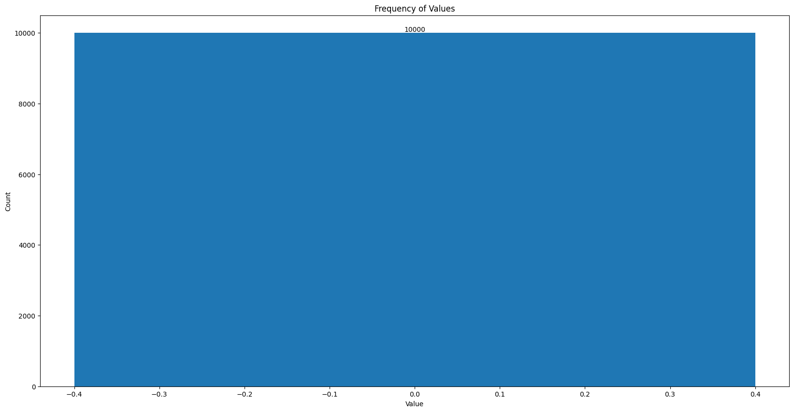
Density-Based Spatial Clustering of Applications with Noise
Groups data points based on their density; no cluster number required.
Eps:the radius of the data circle used for density checks
minPoints:denotes the minimum number of data points required inside the data circle around a single data point
DBSCAN (Sharma, 2020 ):
Three. Algorithms Applying
Label 0, means all being clustered as one cluster
Notes:
Sharma, S. (2020, 9 8). How to Master the Popular DBSCAN Clustering Algorithm for Machine Learning. Retrieved from Analytics Vidhya: https://www.analyticsvidhya.com/blog/2020/09/how-dbscan-clustering-works/

Slide 14
Calculating the distance between each data point and the centroid of each randomly selected cluster
Assigns the data points to different clusters based on the distance values
Iteratively updates the positions of the cluster centroids by calculating the average value of the distances within each cluster.
Kmeans（Kumar, 2021):
Three. Algorithms Applying
Process continues until the centroids no longer change
Notes:
Kumar, S. (2021, 5 7). Clustering Algorithm for data with mixed Categorical and Numerical features. Retrieved from Medium: https://towardsdatascience.com/clustering-algorithm-for-data-with-mixed-categorical-and-numerical-features-d4e3a48066a0

Slide 15
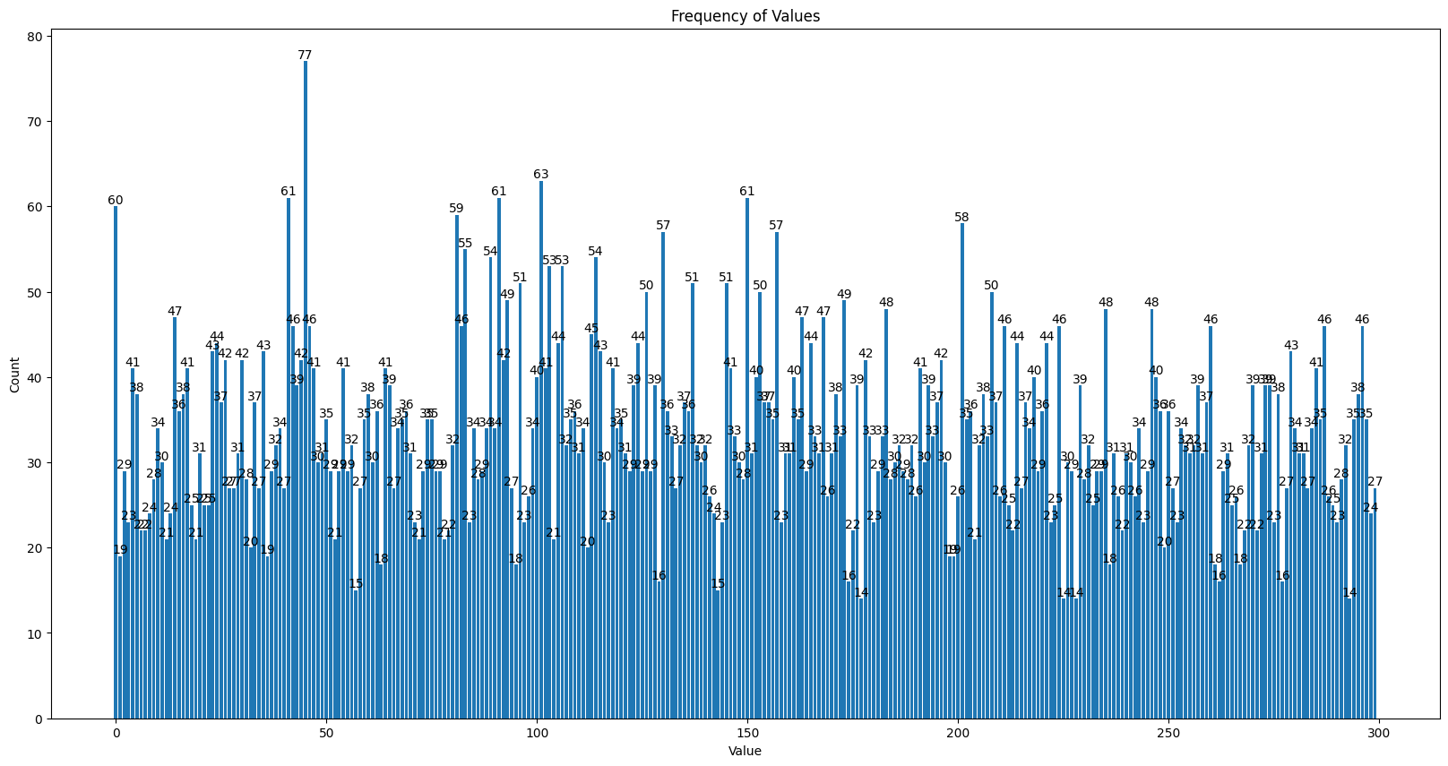
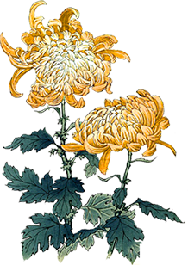
KMeans:
Three. Algorithms Applying
K | Silhouette Score
100 | 0.081
200 | 0.082
300 | 0.082
500 | 0.087
800 | 0.094
1000 | 0.098
K = 300, Min: 14, Max: 77, Silhouette Score: 0.082

Slide 16
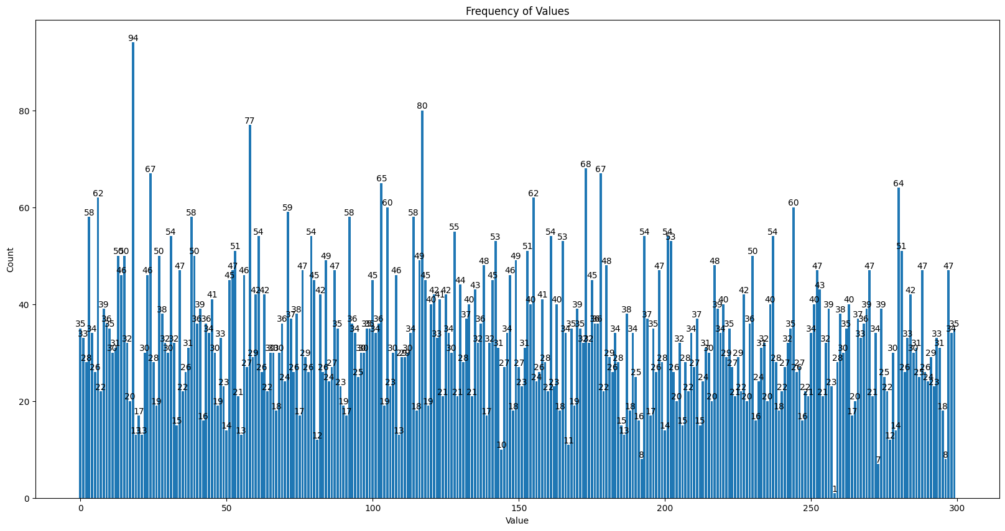
Randomly sampling data points from the dataset instead of processing the entire dataset
A variant of the K-means algorithm specifically designed for large datasets
Mini Batch Kmeans (Kharwal, 2021):
Reduced computation time and improved efficiency
Three. Algorithms Applying
K = 300, Min: 1, Max: 94, Silhouette Score: 0.074
K | Silhouette Score
100 | 0.072
200 | 0.074
300 | 0.074
500 | 0.070
800 | 0.066
Notes:
Kharwal, A. (2021, 9 10). Mini-batch K-means Clustering in Machine Learning. Retrieved from Thecleverprogrammer: https://thecleverprogrammer.com/2021/09/10/mini-batch-k-means-clustering-in-machine-learning/

Slide 17
Gaussian Mixture Model (GMM) (Santos, 2022), (Dobilas, 2021):
Assumes that the data in the dataset can be represented by a mixture of normally distributed clusters, known as Gaussian distribution clusters
Calculates the probability of each data point belonging to different clusters and assigns the data points to specific clusters based on these probabilities
Unlike the k-means algorithm, GMM considers not only the mean values but also the covariance and mixing coefficients of the clusters
Based on a probabilistic model
Three. Algorithms Applying
Notes:
Santos, G. (2022, 1 26). A Simple Introduction to Gaussian Mixture Model (GMM). Retrieved from https://towardsdatascience.com/a-simple-introduction-to-gaussian-mixture-model-gmm-f9fe501eef99
Dobilas, S. (2021, 5 22). GMM: Gaussian Mixture Models — How to Successfully Use It to Cluster Your Data? Retrieved from Medium: https://towardsdatascience.com/gmm-gaussian-mixture-models-how-to-successfully-use-it-to-cluster-your-data-891dc8ac058f

Slide 18

Hierarchy ((Karabiber, Hierarchical Clustering, 2023):
Assumes all the data points as one cluster.
Three. Algorithms Applying
Assumes each data point as a cluster.
Agglomerative Clustering
Divisive Clustering
Cluster the similar clusters/points
Divided the different points into different clusters.
Notes:
Karabiber, F. (2023). Hierarchical Clustering. Retrieved from LearnDataSci: https://www.learndatasci.com/glossary/hierarchical-clustering/#:~:text=a%20real%20dataset-,What%20is%20Hierarchical%20Clustering%3F,hierarchical%20tree%20called%20a%20dendrogram.

Slide 19
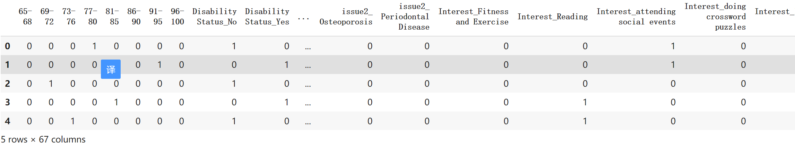
Expanding the contents of each column individually and assessing the consistency of the data points with the expanded contents.
Dataset Adjusting:
Three. Algorithms Applying

Slide 20
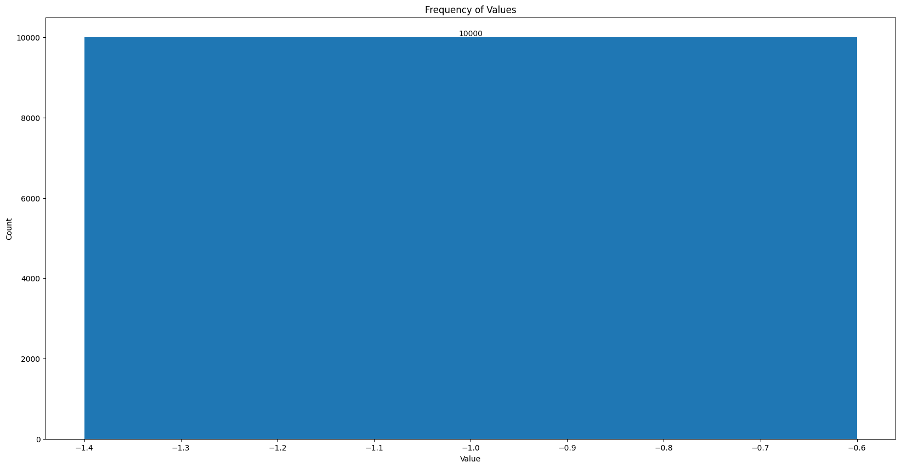
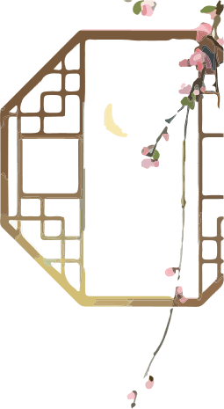
Create a label column assign randomly numbers to test original cluster results.
Randomly Label:
Three. Algorithms Applying
DBSCNE:
Labels from 1 to 300, Silhouette score: -0.052
Label -1, means all being clustered as outliers

Slide 21
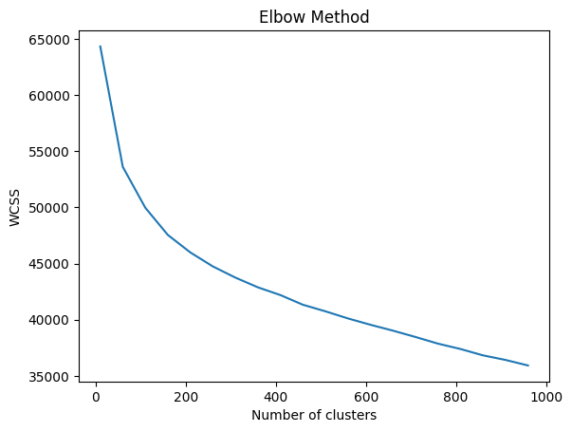
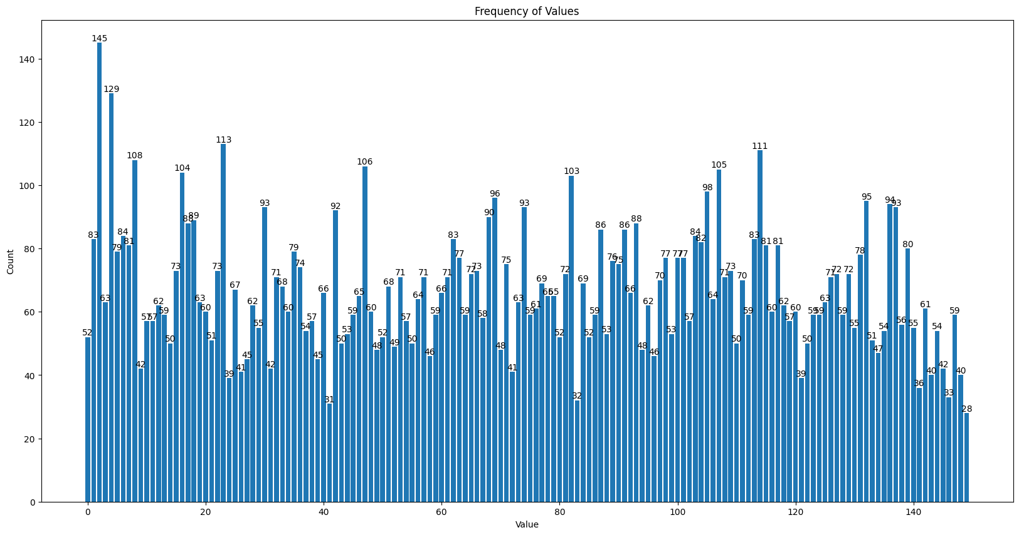
Elbow Method:
Three. Algorithms Applying
KMeans:
Min: 28, Max: 145, Silhouette Score: 0.043
K | Silhouette Score
100 | 0.043
150 | 0.043
200 | 0.041
300 | 0.040

Slide 22
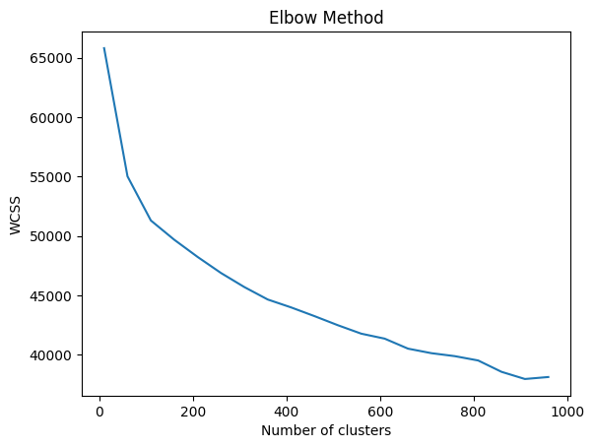
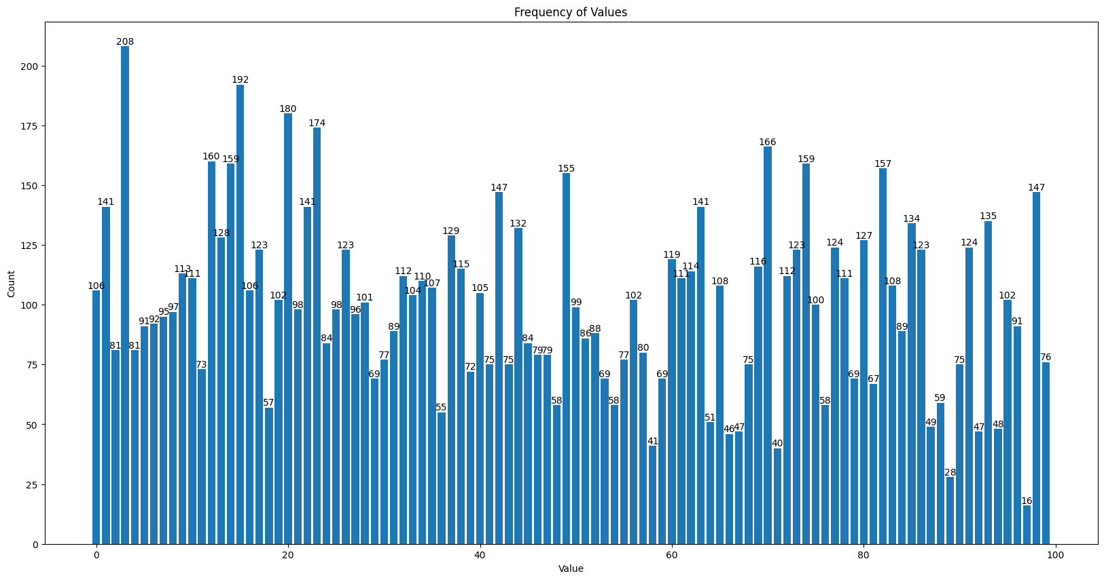
Elbow Method:
Mini Batch KMeans:
Three. Algorithms Applying
Min: 16, Max: 208, Silhouette Score: 0.038
K | Silhouette Score
100 | 0.038
150 | 0.033
200 | 0.026
300 | 0.025

Slide 23
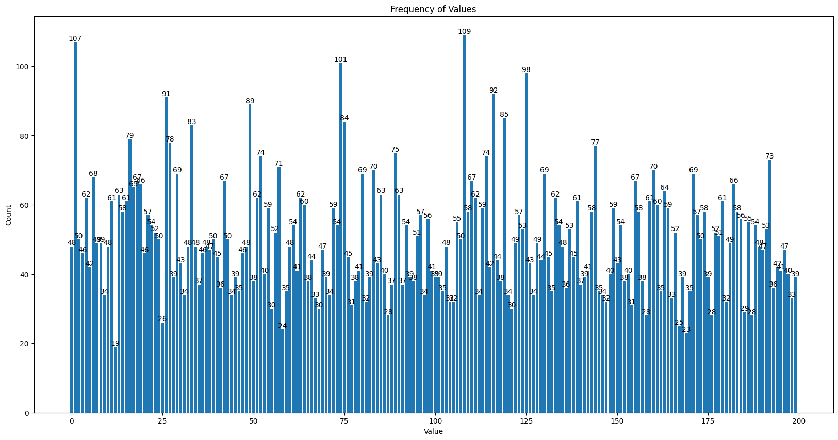
GMM:
Three. Algorithms Applying
K | Silhouette Score
100 | 0.036
150 | 0.040
200 | 0.040
300 | 0.037
K = 200, Min: 19, Max: 109, Silhouette Score: 0.040

Slide 24
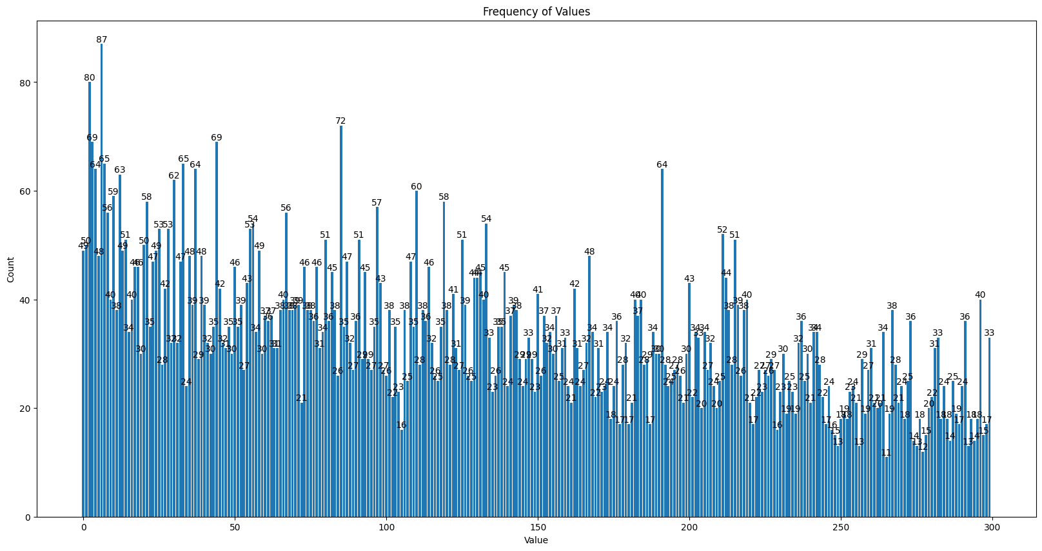
Hierarchy:
Three. Algorithms Applying
K | Silhouette Score
150 | 0.002
200 | 0.004
300 | 0.010
400 | 0.016
500 | 0.019
800 | 0.033
1000 | 0.041
K = 300, Min: 11, Max: 87, Silhouette Score: 0.010

Slide 25
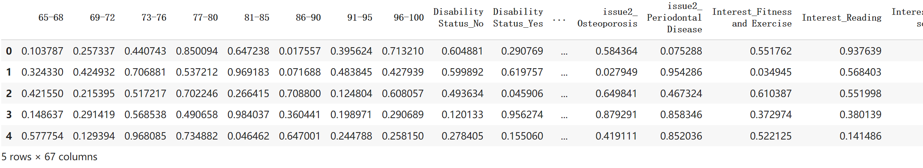
A statistical method for randomly sampling numbers from a distribution with the goal of achieving a more uniform distribution.
It involves dividing the sample space into equally sized intervals and selecting one point from each interval with the same probability.
Latin Hypercube Sampling (LHS) (Zach, 2020):
Three. Algorithms Applying
Testing using KMeans
Notes:
Zach. (2020, 9 13). What is Latin Hypercube Sampling? Retrieved from Statology: https://www.statology.org/latin-hypercube-sampling/

Slide 26
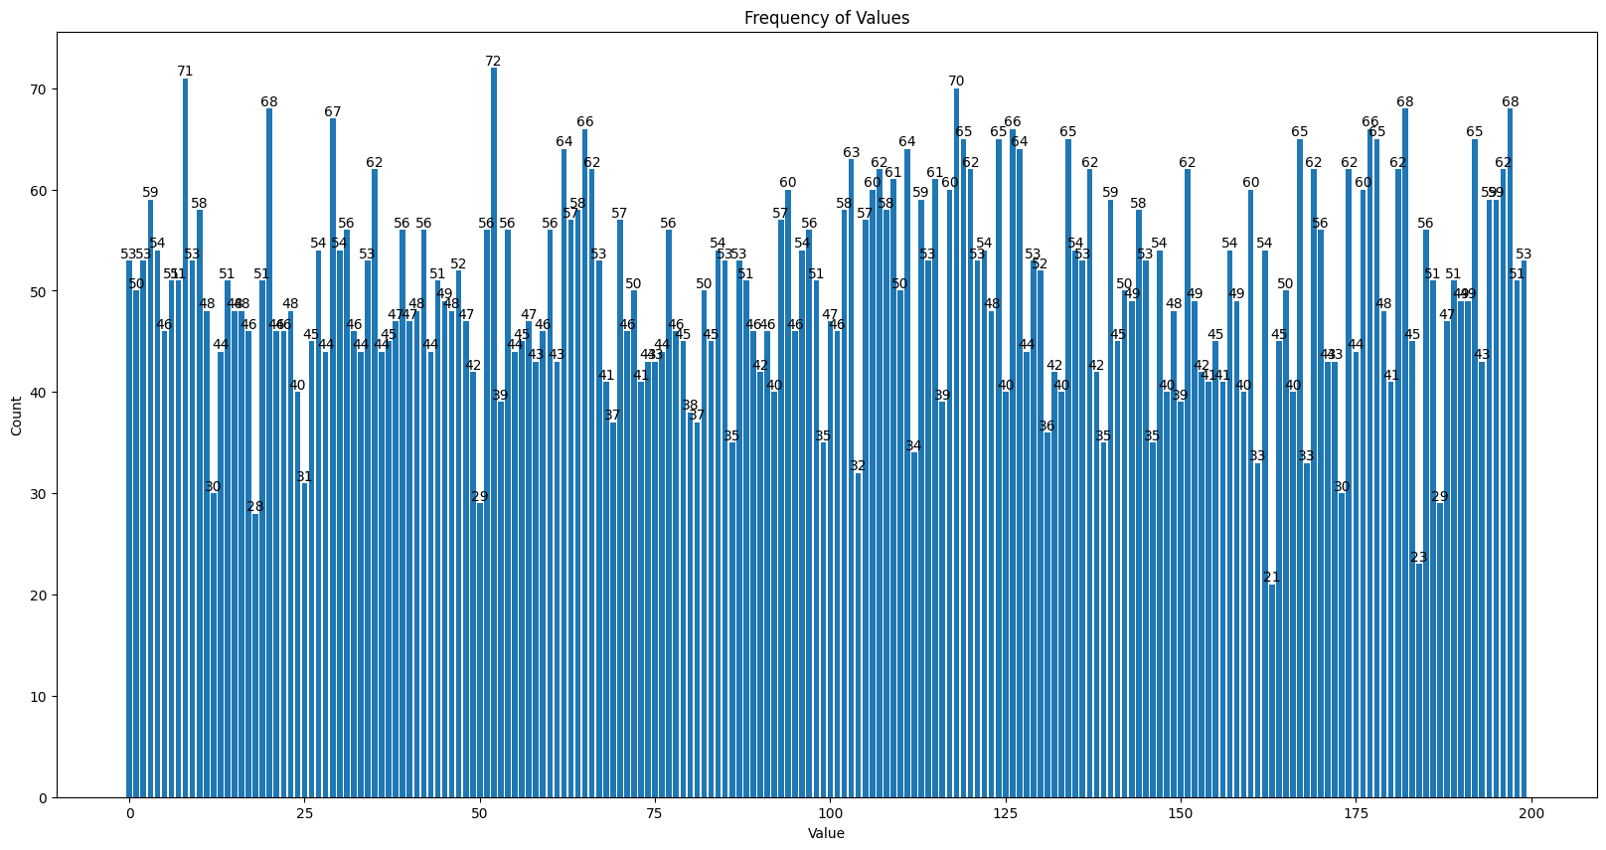
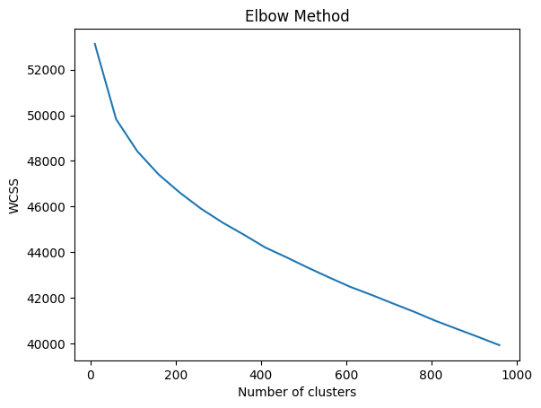
Latin Hypercube Sampling (LHS) (Zach, 2020):
Three. Algorithms Applying
K = 200, Min: 21, Max: 72, Silhouette Score: 0.013
K | Silhouette Score
100 | 0.012
200 | 0.013
300 | 0.010
400 | 0.006
500 | 0.002

Slide 27
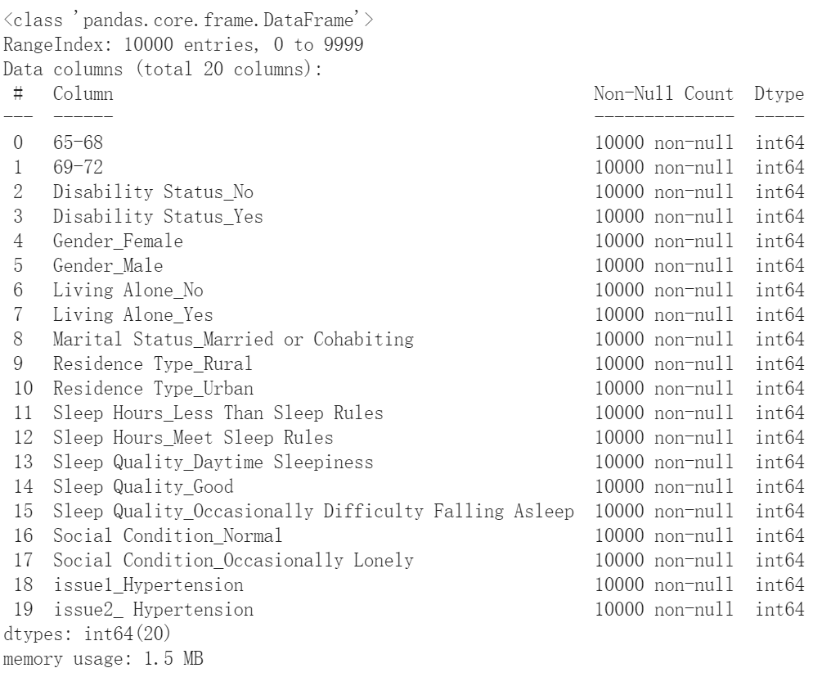
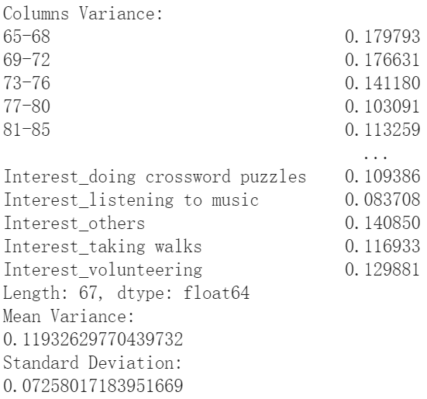
Columns contain bias data points, like contain too much ‘white’ in Ethnicity Column.
Data points over lapping on each other.
Results Analysis:
Three. Algorithms Applying
Lower Silhouette Score.
Calculate variance for each columns
Dataset Adjusting Again:
Select columns with top 30% variance.

Slide 28
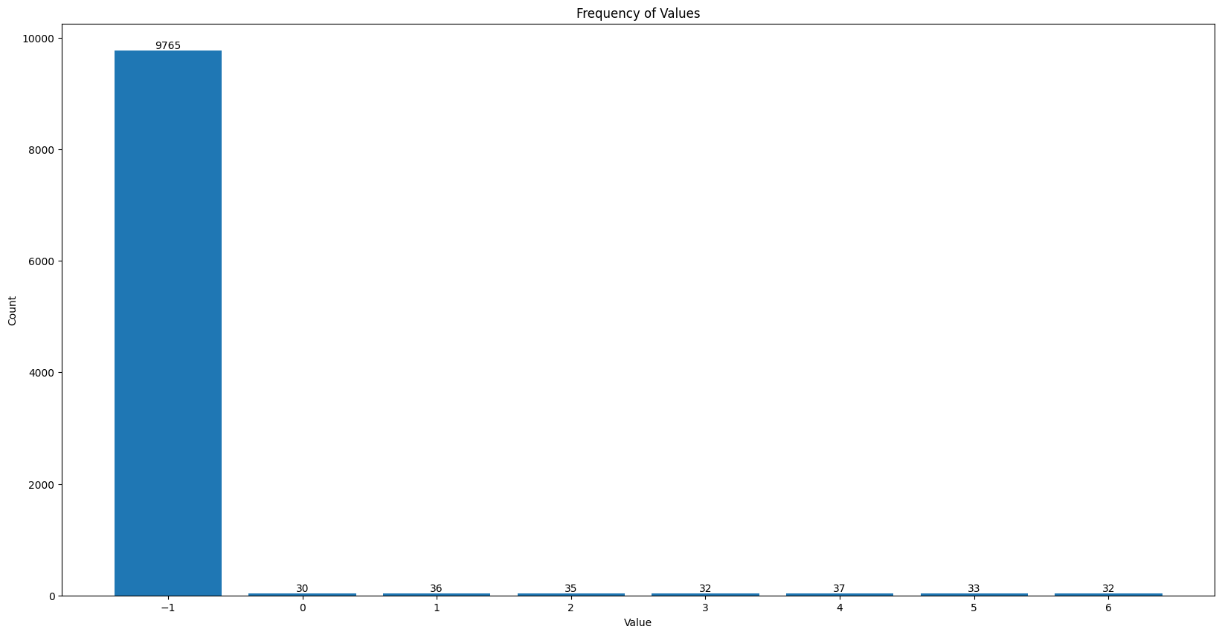
Three. Algorithms Applying
DBSCNE:
Over 97% data points has being clustered as outliers. Silhouette Score: -0.250
eps | Mini points | Silhouette Score
0.5 | 20 | -0.285
0.3 | 20 | -0.285
0.2 | 20 | -0.285
0.5 | 30 | -0.250
0.3 | 30 | -0.250
0.2 | 30 | -0.250

Slide 29
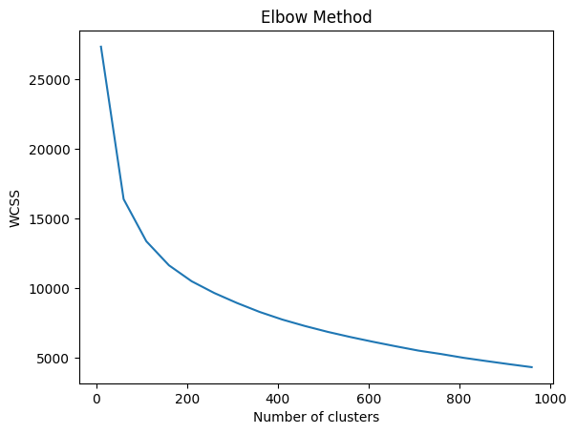
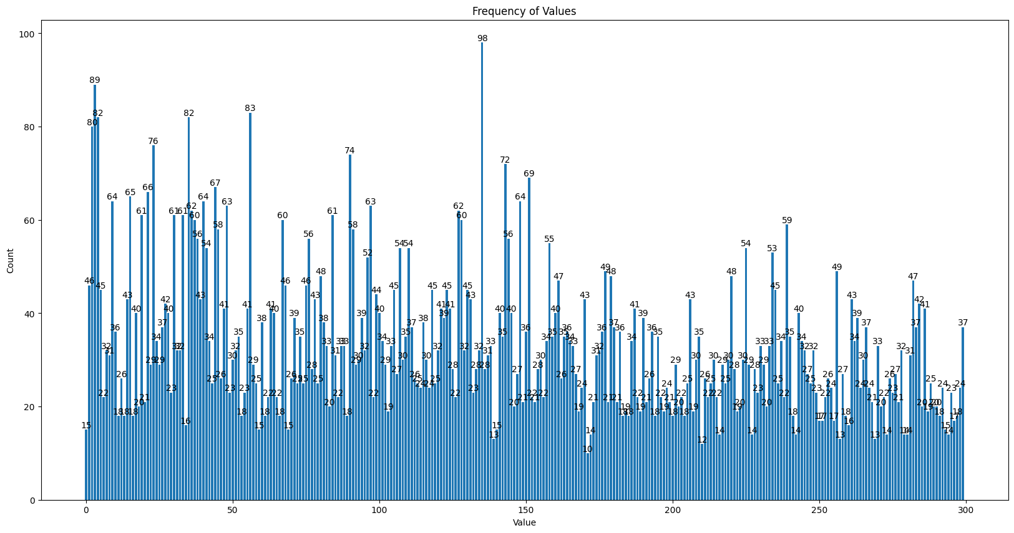
Elbow Method:
KMeans:
Three. Algorithms Applying
K = 300, Min: 10, Max: 98, Silhouette Score: 0.218
K | Silhouette Score
100 | 0.168
200 | 0.195
300 | 0.218
500 | 0.275
800 | 0.363
1000 | 0.416

Slide 30
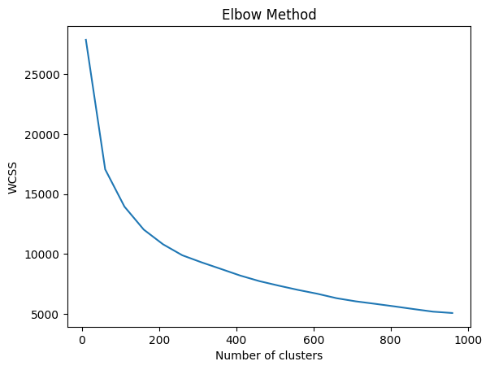
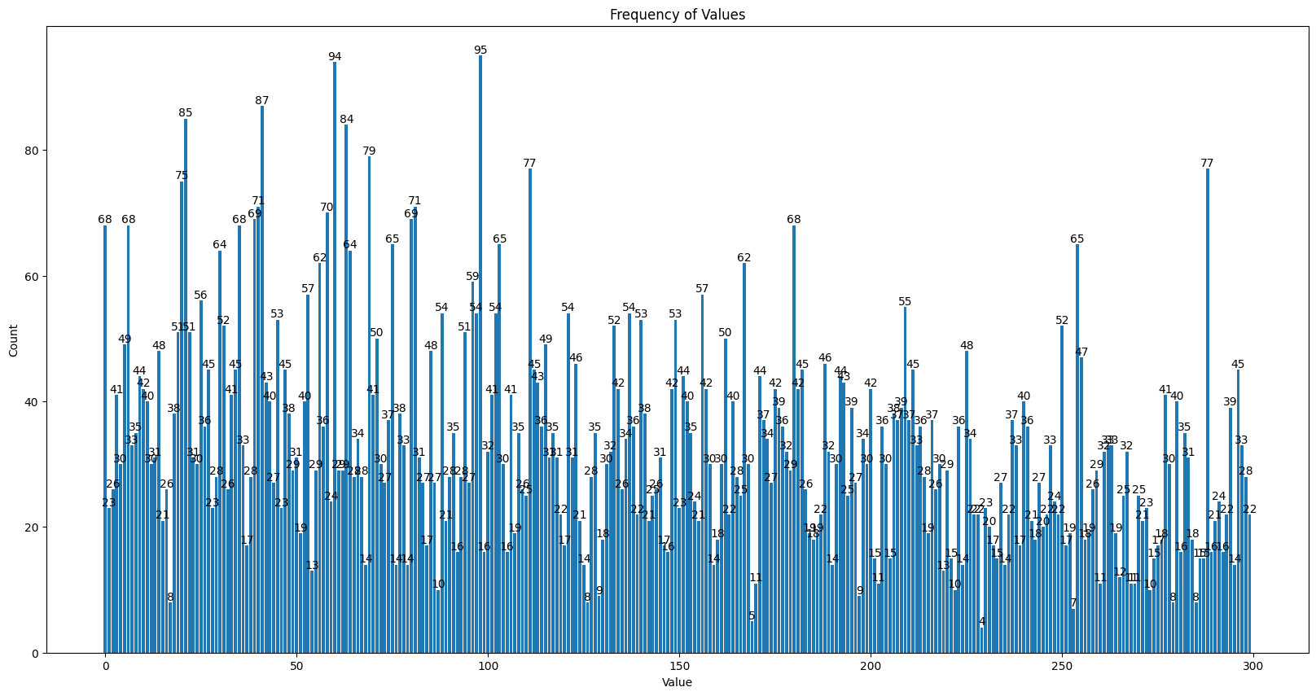
Elbow Method:
Mini Batch KMeans:
Three. Algorithms Applying
k = 300, Min: 4, Max: 95, Silhouette Score: 0.215
K | Silhouette Score
100 | 0.158
200 | 0.193
300 | 0.215
500 | 0.260
800 | 0.336
1000 | 0.367

Slide 31
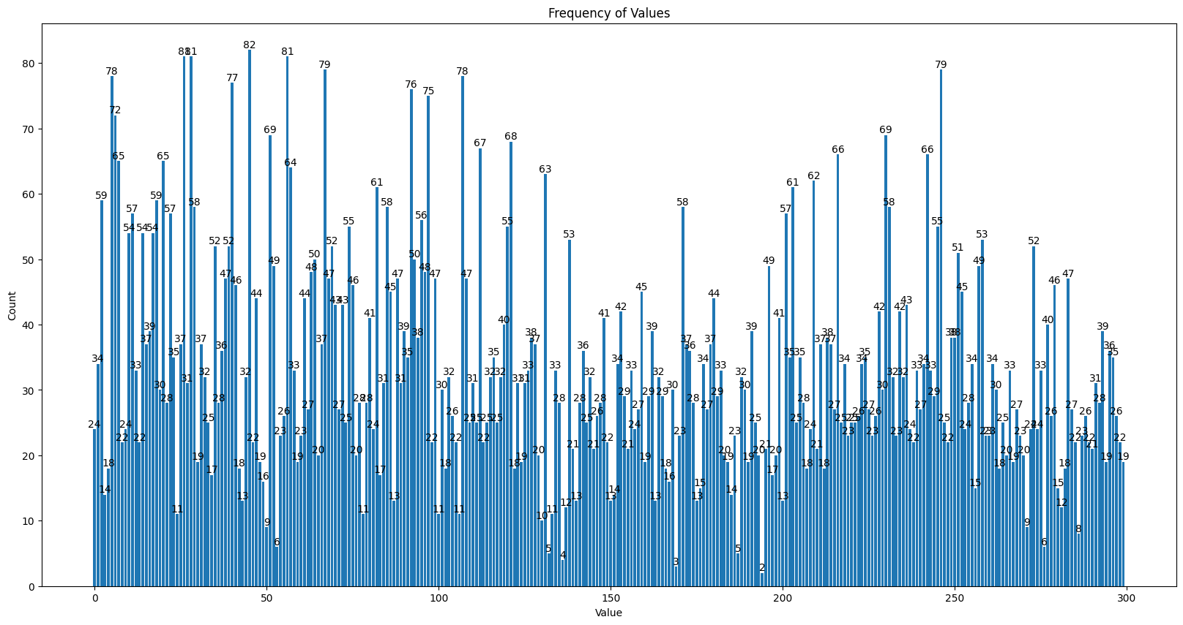
Three. Algorithms Applying
GMM:
K | Silhouette Score
100 | 0.167
200 | 0.186
300 | 0.212
400 | 0.234
500 | 0.265
800 | 0.354
1000 | 0.409
k = 300, Min: 2, Max: 82, Silhouette Score: 0.212

Slide 32
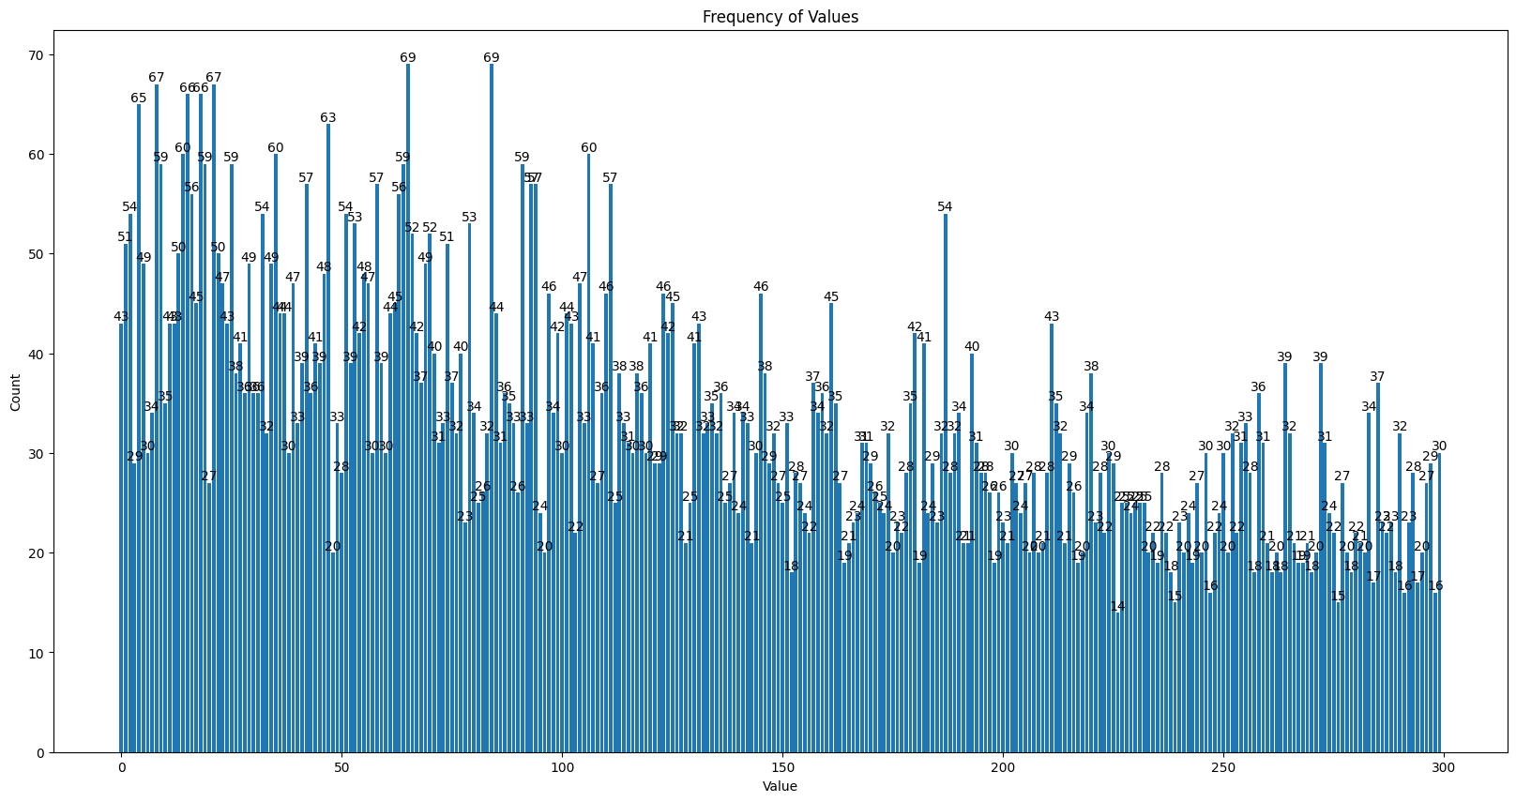
Three. Algorithms Applying
Hierarchy :
K | Silhouette Score
100 | 0.166
200 | 0.185
300 | 0.213
400 | 0.241
500 | 0.268
800 | 0.364
1000 | 0.421
k = 300, Min: 14, Max: 69, Silhouette Score: 0.213

Slide 33
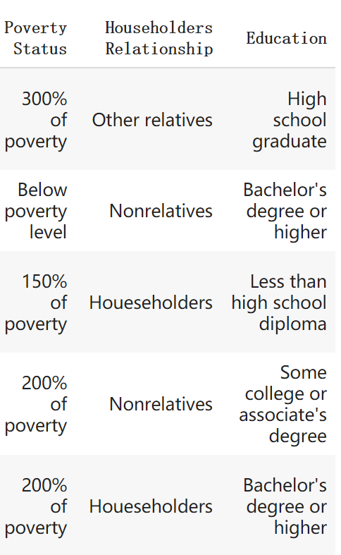
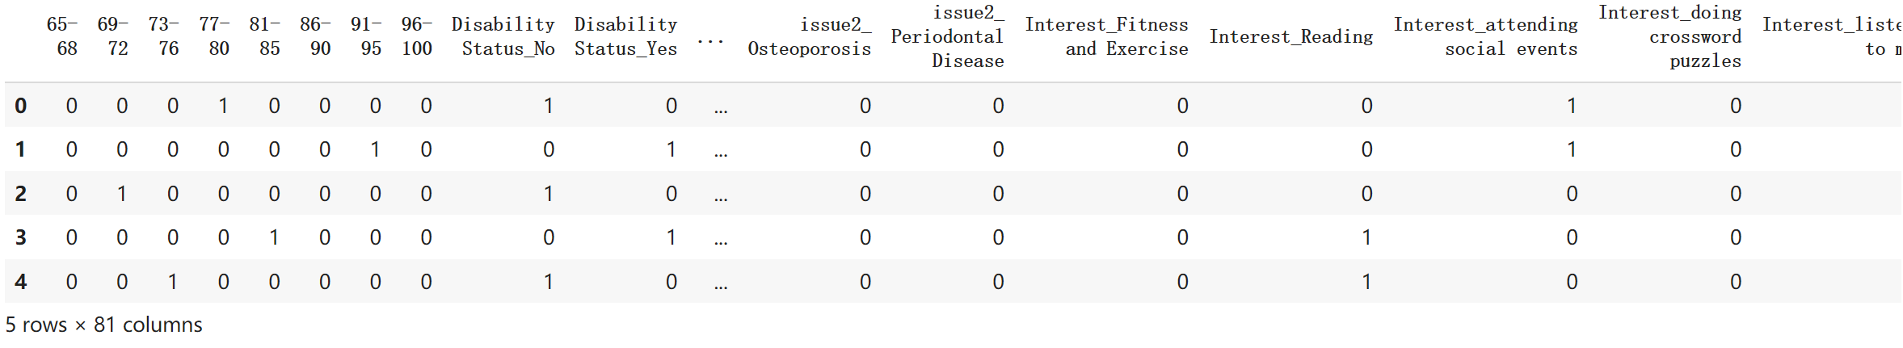
Adding New Data for extend the features:
Adding new features according to American Community Survey (ACS) Demographic and Household Data.
Three. Algorithms Applying
Dataset: 10,000 Rows, 16 Columns
Adjusting to 0&1 array

Slide 34
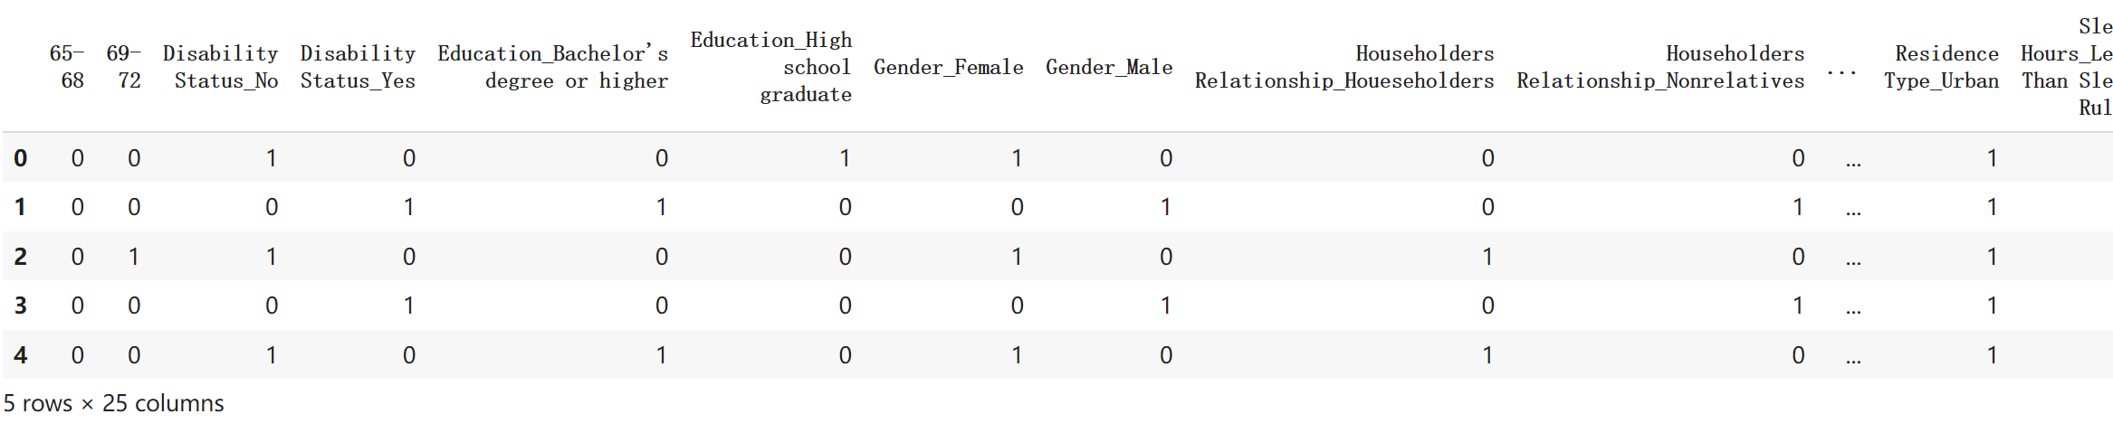
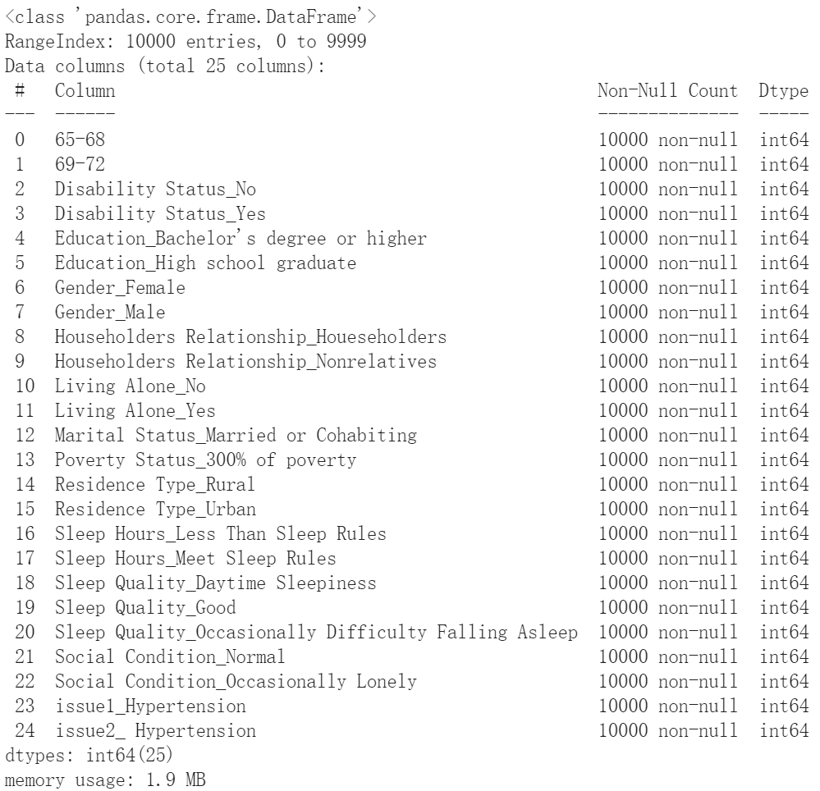
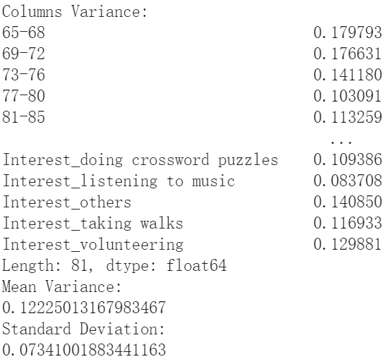
New Data selected top 30% variance:
Three. Algorithms Applying
Selected Columns increase to 25 columns
DBSCNE: All labeled outliers

Slide 35
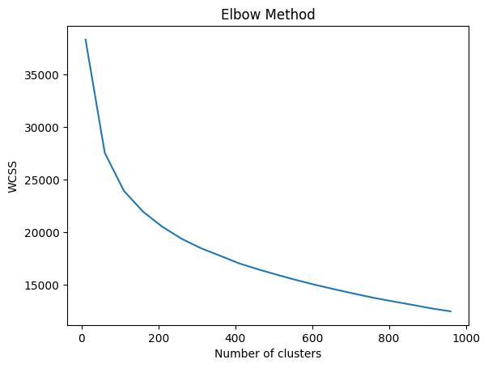
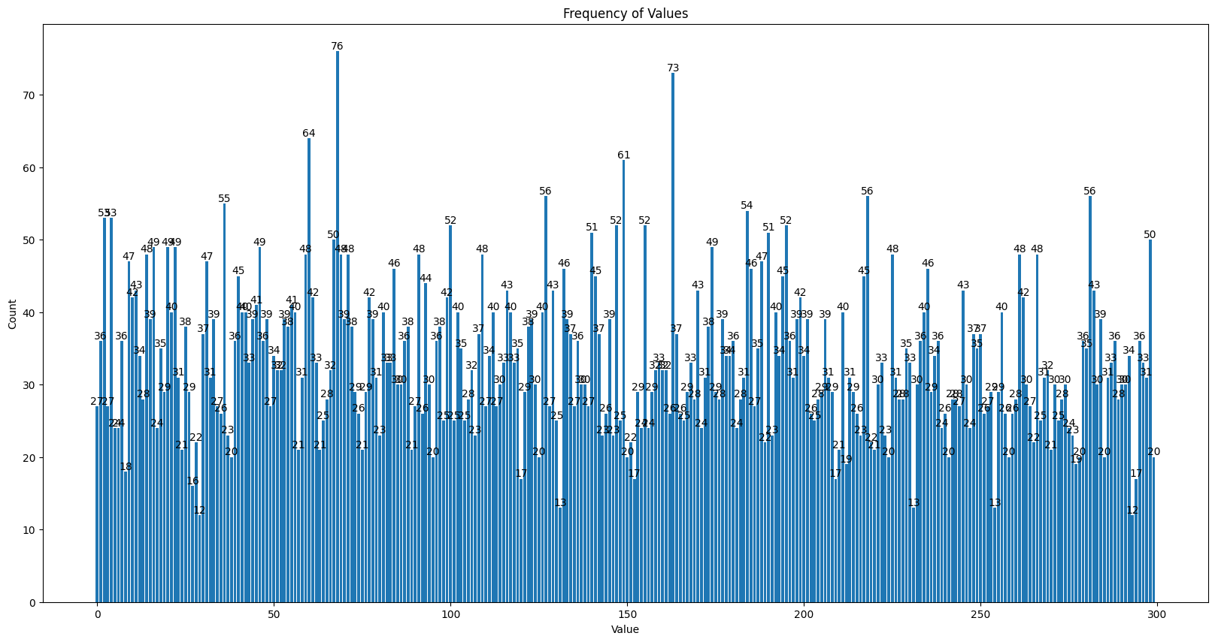
Elbow Method:
KMeans:
Three. Algorithms Applying
K = 300, Min: 12, Max: 76, Silhouette Score: 0.101
K | Silhouette Score
100 | 0.083
200 | 0.094
300 | 0.101
500 | 0.109
800 | 0.120
1000 | 0.130

Slide 36
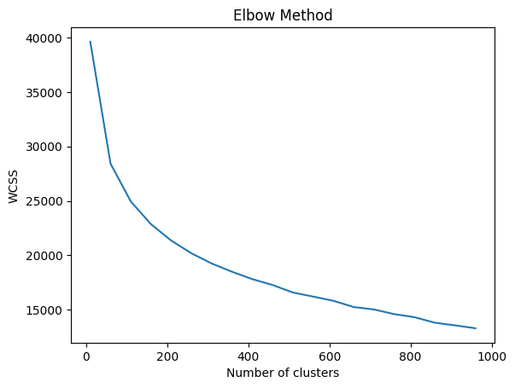
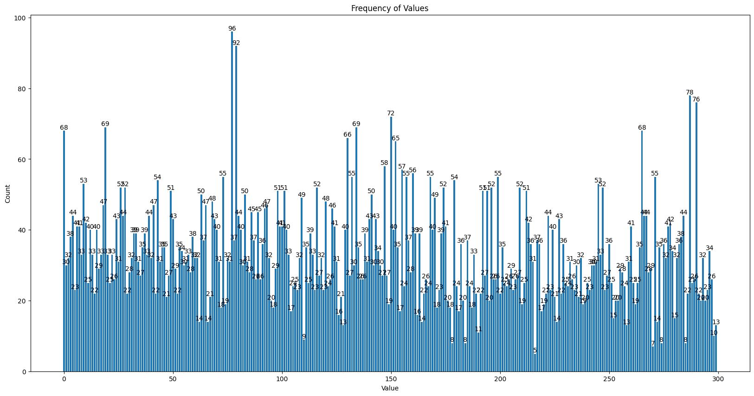
Elbow Method:
Mini Batch KMeans:
Three. Algorithms Applying
K = 300, Min: 5, Max: 96, Silhouette Score: 0.094
K | Silhouette Score
100 | 0.075
200 | 0.087
300 | 0.094
500 | 0.097
800 | 0.104
1000 | 0.108

Slide 37
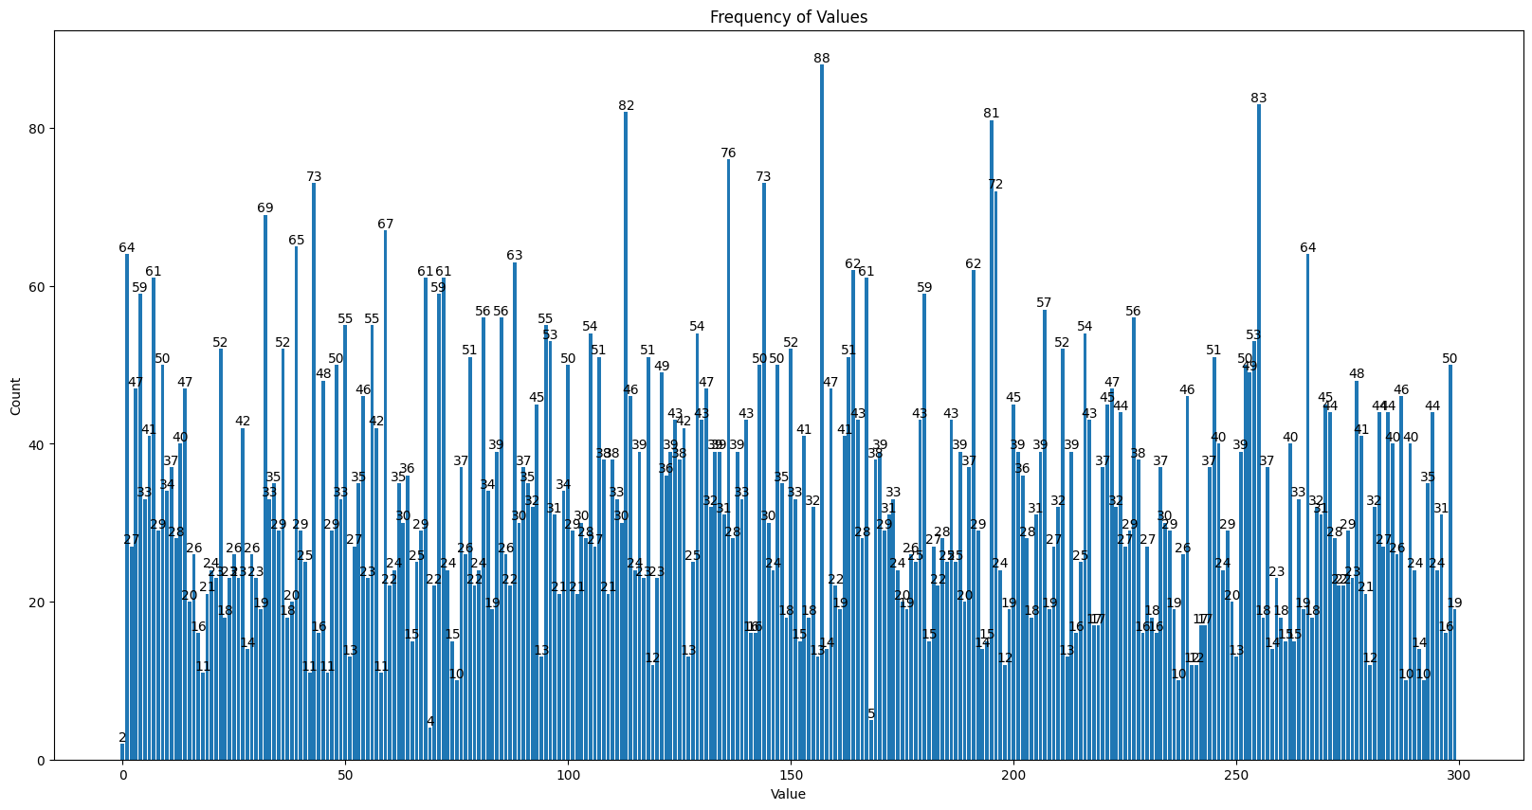
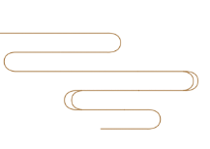
GMM:
Three. Algorithms Applying
K | Silhouette Score
100 | 0.082
200 | 0.088
300 | 0.083
500 | 0.090
800 | 0.103
1000 | 0.114
K = 300, Min: 4, Max: 88, Silhouette Score: 0.083

Slide 38
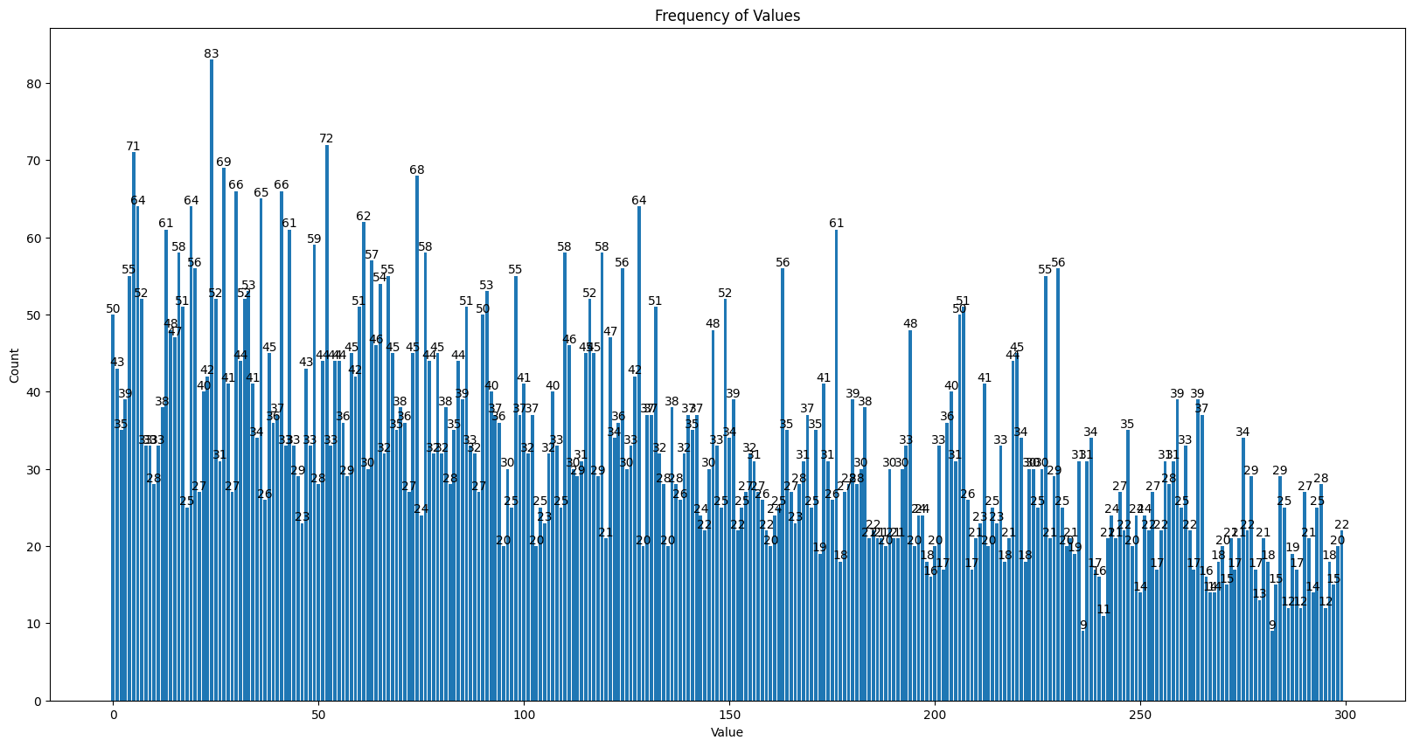
Hierarchy :
Three. Algorithms Applying
K | Silhouette Score
100 | 0.071
200 | 0.074
300 | 0.081
500 | 0.096
800 | 0.117
1000 | 0.130
K = 300, Min: 9, Max: 83, Silhouette Score: 0.081

Slide 39
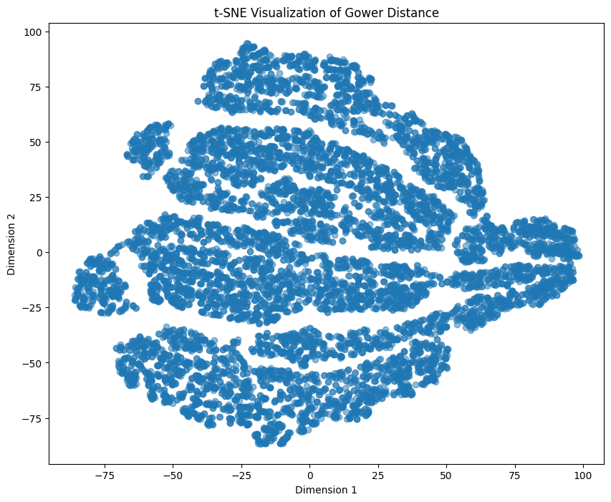
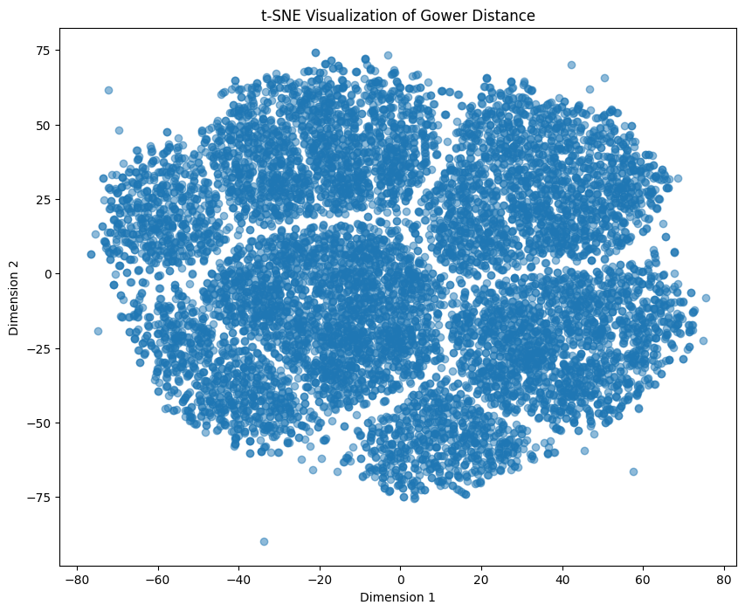
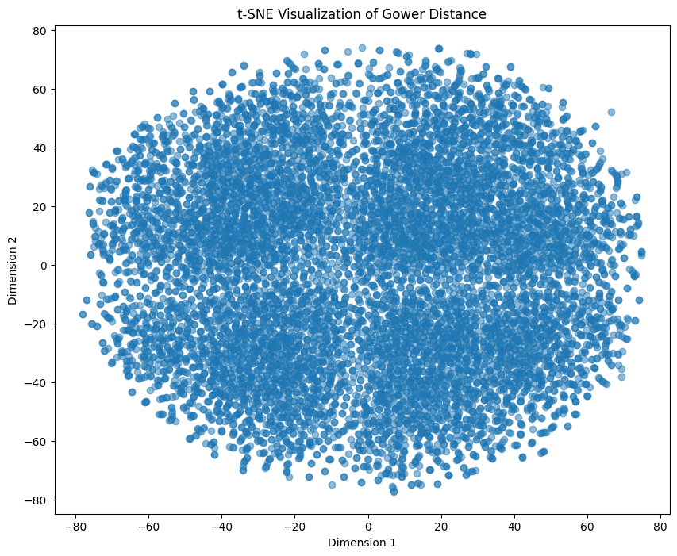


t-Distributed Stochastic Neighbor Embedding
Popular visualization method commonly used for dimensionality reduction
T-SNE (DataTechNotes, 2020) :
Three. Algorithms Applying
0&1 with extra data selected
Gower Distance
0&1 data selected
0&1 data
0&1 with extra data
Notes:
DataTechNotes. (2020, 11 26). TSNE Visualization Example in Python. Retrieved from DataTechNotes: https://www.datatechnotes.com/2020/11/tsne-visualization-example-in-python.html

Slide 40
Four
Conclusion
Overall review, limitations and next steps

Slide 41
Four. Algorithms Results
K = 300 :
Silhouette Score | Gower Distance | 0&1 dataset | 0&1 selected | 0&1 extra selected
Original | / | -0.052 | / | /
KMeans | 0.082 | 0.04 | 0.218 | 0.101
Mini Match KMeans | 0.074 | 0.025 | 0.215 | 0.094
GMM | / | 0.037 | 0.212 | 0.083
Hierarchy | / | 0.01 | 0.213 | 0.081
LHS-KMeans | / | 0.01 | / | /

Slide 42
Four. Algorithms Results
Best k:
Silhouette Score | Gower Distance | 0&1 dataset | 0&1 selected | 0&1 extra selected
KMeans | 0.098(k=1000) | 0.043 (k=150) | 0.416(k=1000) | 0.13(k=1000)
Mini Match KMeans | 0.074(k=300) | 0.038(k=100) | 0.367(k=1000) | 0.108(k=1000)
GMM | / | 0.04(k=200) | 0.409(k=1000) | 0.114(k=1000)
Hierarchy | / | 0.041(k=1000) | 0.421(k=1000) | 0.13(k=1000)
LHS-KMeans | / | 0.013(k=200) | / | /

Slide 43

Limitations
Report used statistical data about the elderly in Canada only, the results of this data study cannot represent the situation of the elderly worldwide.
Generated data points overlapping on each other which lead to the silhouette score not as good as expected.
Future Work:
Adding more data and improve feature selection efficiency.
Figure out the reason why they are being clustered, answer has not been found.
Reality Application: International Student Support System

Slide 44
Thanks

Slide 45
Q & A

Slide 46
References
UneeQ. (2023, 2 22). AI Ethics. Retrieved from UNEEQ: https://www.digitalhumans.com/blog/loneliness-and-the-role-of-conversational-ai-companions
Public Health Agency of Canada. (2020). Aging and Chronic Diseases. Ottawa: Public Health Agency of Canada.
Kesh, S. (2020, 5 19). How to calculate Gower’s Distance using Python. Retrieved from Medium: https://medium.com/analytics-vidhya/concept-of-gowers-distance-and-it-s-application-using-python-b08cf6139ac2
DataTechNotes. (2020, 11 26). TSNE Visualization Example in Python. Retrieved from DataTechNotes: https://www.datatechnotes.com/2020/11/tsne-visualization-example-in-python.html
Saji, B. (2021, 1 20). Elbow Method for Finding the Optimal Number of Clusters in K-Means. Retrieved from Analytics Vidhya: https://www.analyticsvidhya.com/blog/2021/01/in-depth-intuition-of-k-means-clustering-algorithm-in-machine-learning/
Sharma, S. (2020, 9 8). How to Master the Popular DBSCAN Clustering Algorithm for Machine Learning. Retrieved from Analytics Vidhya: https://www.analyticsvidhya.com/blog/2020/09/how-dbscan-clustering-works/
Kumar, S. (2021, 5 7). Clustering Algorithm for data with mixed Categorical and Numerical features. Retrieved from Medium: https://towardsdatascience.com/clustering-algorithm-for-data-with-mixed-categorical-and-numerical-features-d4e3a48066a0
Kharwal, A. (2021, 9 10). Mini-batch K-means Clustering in Machine Learning. Retrieved from Thecleverprogrammer: https://thecleverprogrammer.com/2021/09/10/mini-batch-k-means-clustering-in-machine-learning/
Karabiber, F. (2023). Hierarchical Clustering. Retrieved from LearnDataSci: https://www.learndatasci.com/glossary/hierarchical-clustering/#:~:text=a%20real%20dataset-,What%20is%20Hierarchical%20Clustering%3F,hierarchical%20tree%20called%20a%20dendrogram
Bhardwaj, A. (2020, 5 26). Silhouette Coefficient. Retrieved from Medium: https://towardsdatascience.com/silhouette-coefficient-validating-clustering-techniques-e976bb81d10c
Santos, G. (2022, 1 26). A Simple Introduction to Gaussian Mixture Model (GMM). Retrieved from https://towardsdatascience.com/a-simple-introduction-to-gaussian-mixture-model-gmm-f9fe501eef99
Dobilas, S. (2021, 5 22). GMM: Gaussian Mixture Models — How to Successfully Use It to Cluster Your Data? Retrieved from Medium: https://towardsdatascience.com/gmm-gaussian-mixture-models-how-to-successfully-use-it-to-cluster-your-data-891dc8ac058f
Zach. (2020, 9 13). What is Latin Hypercube Sampling? Retrieved from Statology: https://www.statology.org/latin-hypercube-sampling/

